Slide 1
CHAPTER 11:
Modern Computer Systems
The Architecture of Computer Hardware, Systems Software & Networking:
An Information Technology Approach
5th Edition, Irv Englander
John Wiley and Sons ©2013
PowerPoint slides authored by Angela Clark, University of South Alabama
PowerPoint slides for the 4th edition were authored by Wilson Wong, Bentley University

Slide 2
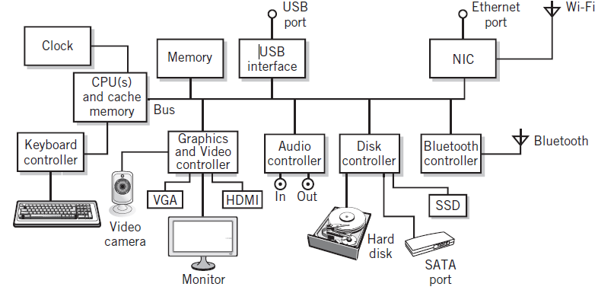
Basic Personal Computer System
Copyright 2013 John Wiley & Sons, Inc.
11-<number>

Slide 3
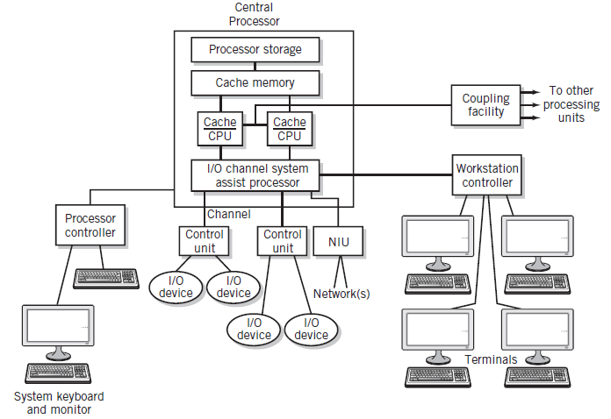
Mainframe Computer System
Copyright 2013 John Wiley & Sons, Inc.
11-<number>

Slide 4
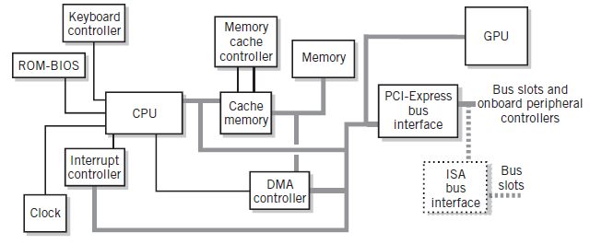
Major PC System Components
Copyright 2013 John Wiley & Sons, Inc.
11-<number>

Slide 5
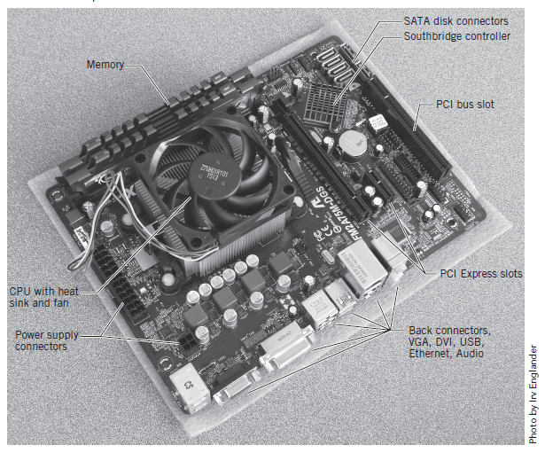
Motherboard
Printed circuit board that holds CPU and related components including backplane
Copyright 2013 John Wiley & Sons, Inc.
11-<number>

Slide 6
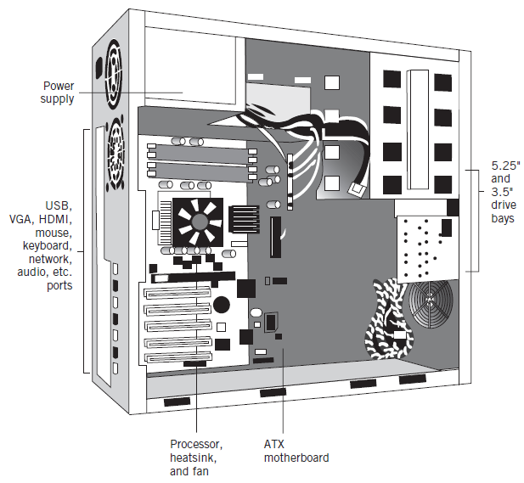
Typical Desktop PC
Copyright 2013 John Wiley & Sons, Inc.
11-<number>

Slide 7
System Architecture
Bus
  Embedded and mobile devices
  Personal computers, workstations, mainframe computers
Channel
  Mainframe computers
Copyright 2013 John Wiley & Sons, Inc.
11-<number>

Slide 8
Bus
Connects CPU and memory
I/O peripherals: on same bus as CPU/memory or separate bus
Physical packaging commonly called backplane
  Also called system bus or external bus
  Example of a broadcast bus
Copyright 2013 John Wiley & Sons, Inc.
11-<number>

Slide 9
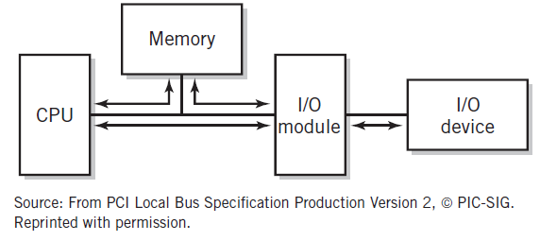
Basic CPU-Memory-I/O Pathway*
Copyright 2013 John Wiley & Sons, Inc.
11-<number>

Slide 10
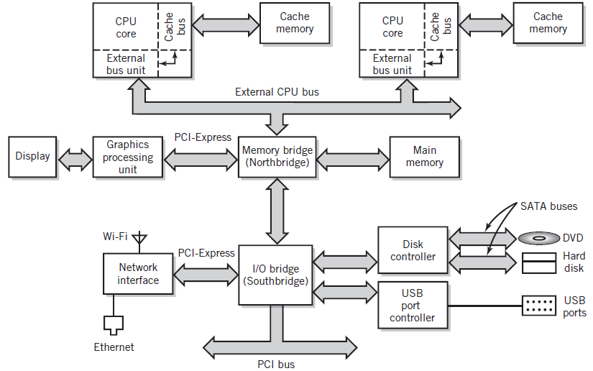
Modern Personal Computer
General Bus Interface Configuration
Copyright 2013 John Wiley & Sons, Inc.
11-<number>

Slide 11
Bus Hierarchy
Processor bus: on-chip
Memory bus (northbridge)
  Connects the memory subsystem and processor
I/O bus (southbridge)
  Connects I/O to the CPU and memory
  Connects all peripheral cards and connectors
  Examples: SATA, Thunderbolt, and USB
Copyright 2013 John Wiley & Sons, Inc.
11-<number>

Slide 12
Bus I/O
Consists of an I/O device, I/O device controller, system bus, and a device driver
Device driver
  Software that controls the I/O devices
Common interface buses
  PCI-Express
  USB – Universal Serial Bus
  SCSI – Small Computer System Interface
  SATA – Serial Advanced Technology Attachment
  Thunderbolt
Copyright 2013 John Wiley & Sons, Inc.
11-<number>

Slide 13
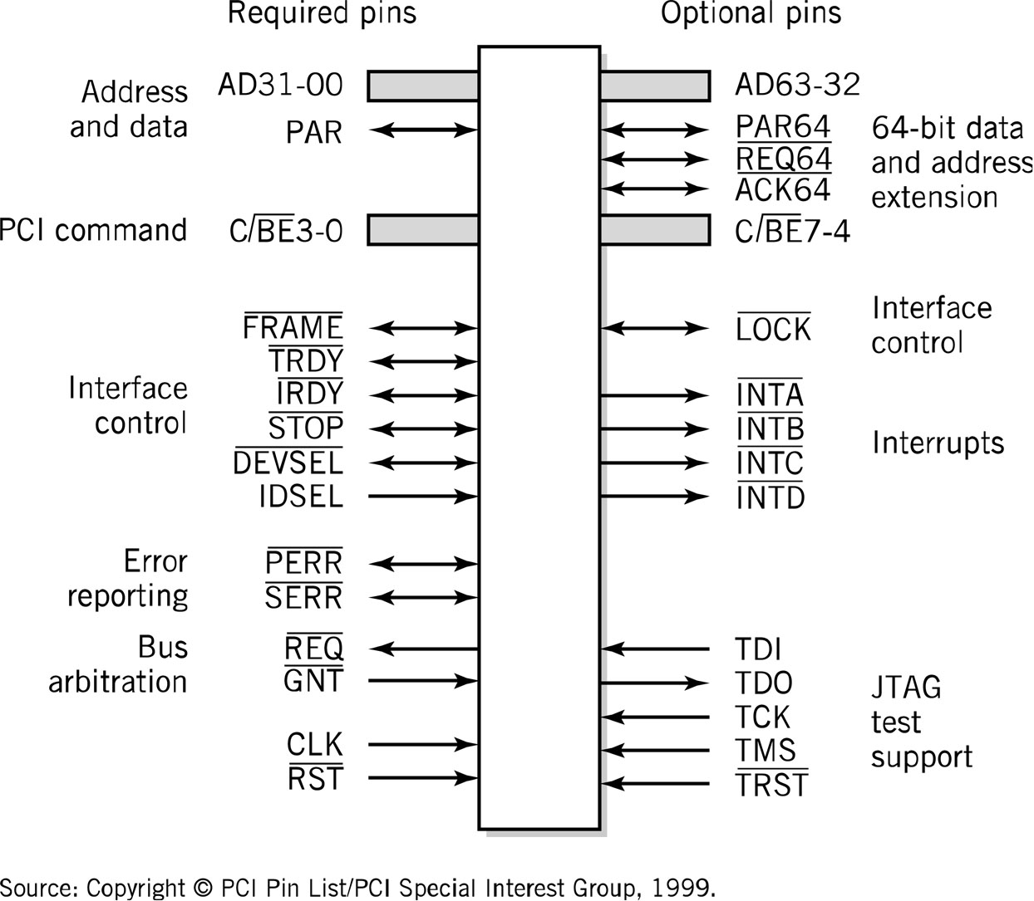
PCI Bus Connections
Copyright 2013 John Wiley & Sons, Inc.
11-<number>

Slide 14
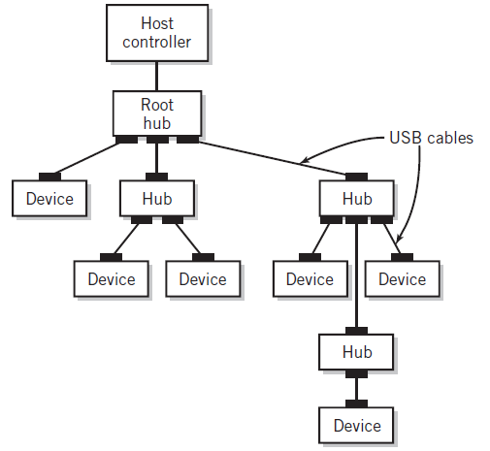
USB
Multipoint bus
Hubs provide multiple connection points for I/O devices
Supports up to 127 devices
USB-3 data transfer rates up to 10 gigabits per second
Topology Example
Copyright 2013 John Wiley & Sons, Inc.
11-<number>

Slide 15
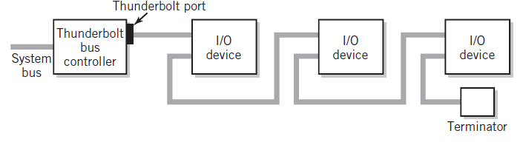
Thunderbolt Bus
Serial, multipoint bus specification
Data transfer rates up to 10Gb each direction
Suitable for high-definition video
Supports up to six daisy-chained devices
Copyright 2013 John Wiley & Sons, Inc.
11-<number>

Slide 16
USB and Thunderbolt
Both serial, multipoint bus specifications
Add/remove devices without powering down
Packet protocol for isochronous data transfer
  Isochronous: delivery at regular time intervals
  Guarantee specified throughput
Copyright 2013 John Wiley & Sons, Inc.
11-<number>

Slide 17
Channel Architecture
Used in IBM mainframe computers
Channel subsystem
  Separate I/O processor that serves as a CPU for I/O operations
  Channel control words
  Programs that transfer data between memory and an I/O device using DMA
Subchannels
  Connected to a control unit module through one or more channel paths
  Similar role to a device controller
Copyright 2013 John Wiley & Sons, Inc.
11-<number>

Slide 18
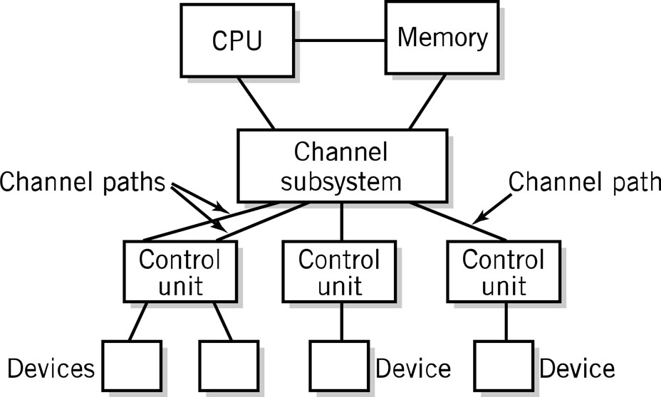
I/O Channel Architecture
Copyright 2013 John Wiley & Sons, Inc.
11-<number>

Slide 19
Clusters
Multi-computer systems
Loosely-coupled computers
Each system has its own CPU, memory, and I/O facilities
Each system is known as a node of the cluster
Two ways to configure
  Shared-nothing model
  Shared-disk model
Copyright 2013 John Wiley & Sons, Inc.
11-<number>

Slide 20
Advantages of Clusters
Increased computing power by combining the power of individual computer systems
  Inherently scalable
  Cheaper than using a single large computer
  Used for high performance computing systems
Fault-tolerance
  Failure in one node does not bring down the entire system
  Failover – processing by failed node is switched to other nodes
High Availability
Load Balancing
  can be attained either through software and/or through geographically distributed location of nodes
Copyright 2013 John Wiley & Sons, Inc.
11-<number>

Slide 21
Shared-Nothing Model
High speed link between nodes
No sharing of resources
Partitioning of work through division of data
Advantage
  Reduced communication between nodes
Disadvantage
  Can result in inefficient division of work
Copyright 2013 John Wiley & Sons, Inc.
11-<number>

Slide 22
Shared-Disk Model
High speed link between nodes
Disk drives are shared between nodes
Advantage
  Better load balancing
Disadvantage
  Complex software required for transactional processing (lock, commit phases)
Copyright 2013 John Wiley & Sons, Inc.
11-<number>

Slide 23
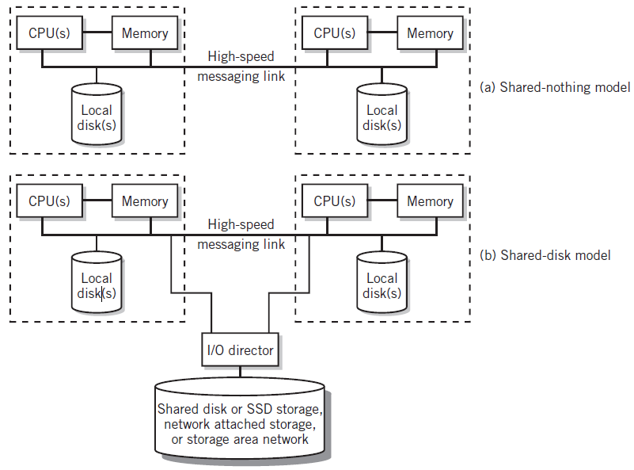
Cluster Models
Copyright 2013 John Wiley & Sons, Inc.
11-<number>

Slide 24
Beowulf Clusters
Simple and highly configurable
Low cost
Networked
  Computers connected to one another by a private Ethernet network
  Connection to an external network is through a single gateway computer
Configuration
  COTS – Commodity-off-the-shelf components such as inexpensive computers
  Blade components – computers mounted on a motherboard that are plugged into connectors on a rack
  Either shared-disk or shared-nothing model
Copyright 2013 John Wiley & Sons, Inc.
11-<number>

Slide 25
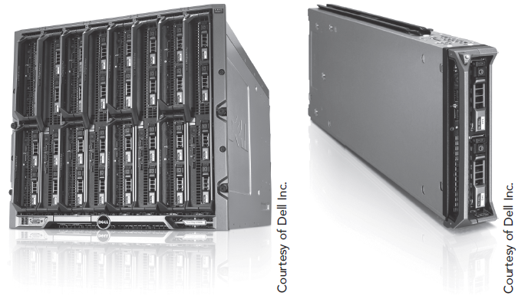
Blade and Rack of Beowulf Cluster
Copyright 2013 John Wiley & Sons, Inc.
11-<number>

Slide 26
High Performance Computing
Also called supercomputing
Clusters of power machines or larger Beowulf blade clusters
  Well suited for problems that can be broken into subtasks
Cloud systems: spread across number of virtual computers
Grid computing
  Supercomputer performance through distributing CPU processing to the spare CPU cycles of personal computers connected to a network
Copyright 2013 John Wiley & Sons, Inc.
11-<number>

Slide 27
Copyright 2013 John Wiley & Sons
All rights reserved. Reproduction or translation of this work beyond that permitted in section 117 of the 1976 United States Copyright Act without express permission of the copyright owner is unlawful. Request for further information should be addressed to the Permissions Department, John Wiley & Sons, Inc. The purchaser may make back-up copies for his/her own use only and not for distribution or resale. The Publisher assumes no responsibility for errors, omissions, or damages caused by the use of these programs or from the use of the information contained herein.
Copyright 2013 John Wiley & Sons, Inc.
11-<number>

